Slide 2
People with no ear for music say that it all sounds the same, but lovers of Bach, Handel, Beethoven, and Brahms know better. So, too, people who lack spiritual concern or factual knowledge or both tell us that the world’s religions are all really the same, and one is as good as the other, so it really doesn’t matter which religion you choose.

Slide 3
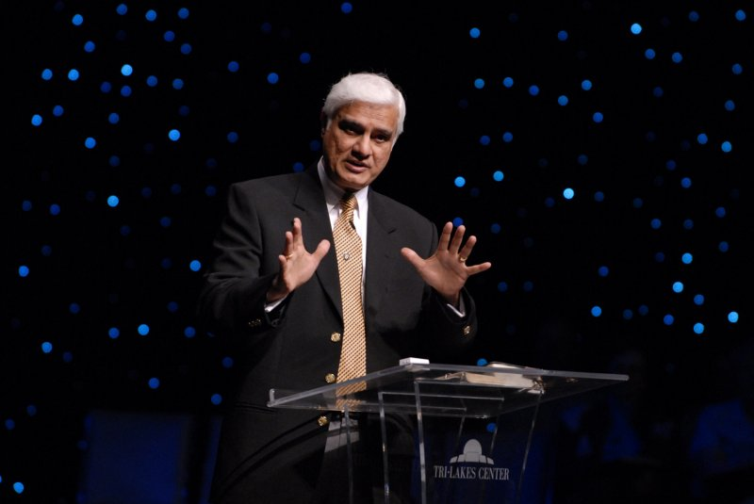
Could all the religions of the world be true?
Dr. Ravi Zacharias. Christian apologist, author, and teacher has observed that most people think that all the religions of the world are essentially the same and only superficially different. But the opposite, he says, is the case: “The religions of the world are essentially different and only superficially the same.”

Slide 4
A Japanese proverb says,
Wrong! Not all trails necessarily lead everybody to the top of the mountain.
To begin with let’s see two major religions we have in Japan.
"There are many paths up the Mountain,
but the view of the moon from the top is the same."

Slide 5
Shinto religion found primarily in Japan, is animistic, believing that gods (kami) reside in all creatures – even trees, the soil, or objects. But let us not think of these gods as distinct from the objects they inhabit; they are a part of the natural world. So the gods of Shinto were numerous. According to the Japanese mythology there are eight million gods. There were no specific leaders in the Shinto religion, nor any books of scripture. From the 19th century it came to be regarded as the national religion of Japan, and the Emperor became deified.

Slide 6
During the World War II all Japanese were forced to worship Him and many young loyal pilots sacrificed their lives as “Kamikaze attack” (God’s Wind suicide plane). However, after the war the practice of the religion was separated from the government, and worship also became limited to the local shrines and only remained as tradition. Today the majority of Japanese have less interest and the influence today is very small. We only can see traditional weｄding ceremonies and festivals in the local towns.

Slide 7
Buddhism reached Japan in the sixth century via China and Korea. At the beginning of the seventh century the crown prince Shotoku who was in charge of Old Japan made a deep study of Buddhism and spread the belief. Up until the twelfth century Buddhism was the religion of the aristocracy only, but from about the thirteenth century it became very popular among the common people. At about this time ZEN became widespread among the samurai class.

Slide 8
Since those times and up to the present day, Buddhism has been the principal religion of the Japanese people.
Buddhism holds that the ultimate stake is one of self-enlightenment attained by being awakened to the truth. They don't even believe in a god (or gods). When a Buddhist prays, he is actually meditating, speaking only to himself to attain the Nirvana (state of peace and happiness) or making connection with ancestors for peaceful rest and protection.

Slide 9
Have you ever seen God? Though you and I have never chiseled a god out of stone, we all face the strong temptation of remaking our idea of God to conform to our image. Freud argued that the hopes and dreams of humans resemble the alleged characteristics of “God” so closely that people simply transfer their hopes and wishes to an imaginary being. So, does God create man or has man created God?
The answer is found in Rom. 1:20-25 where Paul is speaking to the Roman church.

Slide 10
“For since the creation of the world God’s invisible qualities—his eternal power and divine nature—have been clearly seen, being understood from what has been made, so that people are without excuse. For although they knew God, they neither glorified him as God nor gave thanks to him, but their thinking became futile and their foolish hearts were darkened. Although they claimed to be wise, they became fools and exchanged the glory of the immortal God for images made to look like a mortal human being and birds and animals and reptiles. Therefore God gave them over in the sinful desires of their hearts to sexual impurity for the degrading of their bodies with one another. They exchanged the truth about God for a lie, and worshiped and served created things rather than the Creator—who is forever praised. Amen.”

Slide 11
Yes, individuals and cultures can create gods.
When man saw himself as the center of all knowledge, he defined religion according to his own expectations and desires. Religion was no longer thought of as the quest for man to rightly adjust his life to the demands of God, but as a system of beliefs that helps him achieve his full potential.
Before, the good of man consisted ultimately in glorifying God; now the glory of God consist in the good of man. Before, man lived to glorify God; now God lives to serve man.

Slide 12
Two hundred years after the Reformation of the sixteenth century, Europe experienced the Enlightenment. Many writers and scientists began to argue that science and reason were more important than religion and tradition. However, the Enlightenment was not opposed to religion; it simply declared that our knowledge of God should not come through the Bible but through the universal light of nature. As such all religions of the world were essentially equal, based as they were on natural observation and experience. The Bible was seen as a helpful book, but it was not considered a revelation from a personal God. Human reason was elevated above revelation.

Slide 13
The Enlightenment was a mixed blessing. On the one hand it did emphasize religious freedom and tolerance in the best sense of the word. But unfortunately, the Enlightenment also ushered in deep darkness. When Germany and all of Europe chose to opt for that kinder and gentler theology, the gospel of Christ was obscured. Man became the judge of religion and morality, and dictators such as Napoleon in France, Lenin in Russia appeared and took over the nation.

Slide 14
It is not simply a historical accident that during the “Holocaust”, millions of Jews were killed by the Nazis in the 1930s and 1940s. It was a crime that was committed in the name of freedom. Hitler’s concentration camps is pure evidence that shows mankind using its coveted freedom to disown God, with that, a worse tyranny follows because when man uses his freedom to disregard God, he is on his own in the world.

Slide 15
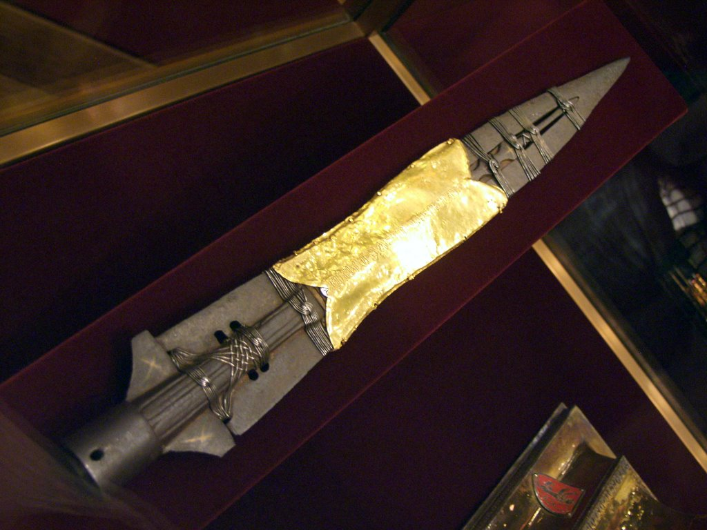
In the Hofberg Library in Vienna, Austria, where there is a spear believed by many to be the one used to pierce the side of Christ. One day when Adolph Hitler was in his early twenties, he overheard a tour guide describe the spear for a group of guests, “This spear is shrouded in mystery; whoever unlocks its secrets will rule the
World.”

Slide 16
Later Hitler said that those words changed his whole life. Hitler, spent four years of his life in Vienna, he spent all his free time in the Hofberg Library, reading books on history and the occult. He became an expert in Eastern religions and known to purchase such books in used book stores, and then resell them so he could buy more. After reading he comment about the mystery of that spear, Hitler became fascinated with it. He read all he could about its history, trying to determine whether it could indeed be traced back to the time of Christ.

Slide 17
He traced it back to the time of Constantine and believed that the emperor had it in hand when he conquered Rome in A.D. 314. He noted that when they had it in their possession, they were victorious; when it fell out of their sphere of ownership, their empire crumbled. He would stand staring at it for hours, inviting its hidden powers to invade his soul. He felt as though he himself had held it in his hands in an earlier century. He was bewitched by its mysteries and power.

Slide 18
When he left Vienna to go to Munich, he soon surrounded himself with those who were dedicated to the pursuit of occult experiences. Chief mentor to Hitler was Dietrich Eckart who claimed that he had received a satanic annunciation and that he was destined to prepare the vessel of the Antichrist, the man who would be inspired by Lucifer to conquer the world. Hitler assumed the uncontested leadership of the Nazi party in 1921, the year he celebrated his thirtieth birthday.

Slide 19
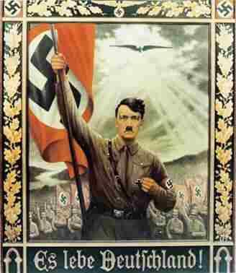
After he conquered Vienna, he entered the Hofberg and took the spear from behind the glass and clutched it to his bosom for the first time. “It was as though I were holding the whole world in my hands.” It became for him one of many bridges to occult
powers. This spear was taken to
Nuremberg under heavy guard;
and through a fluke of mistaken
identity, it fell into the hands of
Americans on the day Hitler
committed suicide in his bunker
in Berlin.

Slide 20
Thus, Hitler was thoroughly changed into a tool of Satan. Satan evidently indwelled in this man, taking total possession of his every word and movement. This transformation of consciousness is Satan’s most dazzling deception. He wants not only the Antichrist but all humans to have a “demonic new birth” which parallels Christ’s teachings, “you must be born again.” Think of the delight he receives when people have an encounter with him and think it is an experience with the living God.

Slide 21
“Therefore if any man is in Christ, he is a new creature; the old tings passed away; behold, new things have come”. ( II Cor. 5:17)
When Thomas ask Jesus,” Lord, we do not know where You are going, how do we know the way?” Jesus said to him. “I am the way, and the truth, and the life; no one comes to the Father, but by Me”. (John 14:6)
“If you abide in My word, then you are truly disciples of Mine; and you shall know the truth and the truth shall make you free” (John 8:31-32)

Slide 22
Apostle Paul also declared;
“And there is salvation in no one else; for there is no other name under heaven that has been given among men, by which we must be saved” (Acts 4:12)
Then Paul also challenged the church in Rome;
“How then shall they believe in Him whom they have not heard? And how shall they believe in Him whom they have not heard? And how shall they hear without a preacher?.... So faith comes from hearing, and hearing by the word of Christ” (Romans 10:14, 17) The apostles stressed that it is through His name alone that salvation comes.

Slide 23
There might be some good ethical teaching in other religions. Buddhism in particular stresses a form of selfless devotion that appears to have something in common with Christianity. We should expect this, since all people are created in the image of God and have a moral consciousness. But all these religions fail at the most central point; namely the question of how sinners can be reconciled to God. Only Christianity has the way through Jesus who died on the Cross

Slide 24
The figure of Jesus Christ, as portrayed in the gospel history, came in the flesh; spoke of Himself as the Son of God; identified Himself as future judge of the world, after being crucified, came alive from the dead, and met His disciples again. He entered the world by a miraculous conception and birth, and fulfilled in it a miraculous ministry, was seen to leave it by a miraculous ascension; and whose disciples for two thousand years have been sure that He actually shares their life, as they share His.

Slide 25
Why, no other religious leader and no other religious experience has ever existed remotely like this! Christianity is truly a unique religion. This fact ought to be beyond dispute. Our multi-religious world is going through a bad patch of failings to distinguish the differences amongst all world religions. But we as Christ followers can see the difference. As we see conflict with one another, how can unity be achieved? And what can we do? On Mars Hill, Paul stood in the midst of these people and said;

Slide 26
“While Paul was waiting for them in Athens, he was greatly distressed to see that the city was full of idols. So he reasoned in the synagogue with both Jews and God-fearing Greeks, as well as in the marketplace day by day with those who happened to be there. A group of Epicurean and Stoic philosophers began to debate with him. Some of them asked, “What is this babbler trying to say?” Others remarked, “He seems to be advocating foreign gods.” They said this because Paul was preaching the good news about Jesus and the resurrection. Then they took him and brought him to a meeting of the Areopagus, where they said to him, “May we know what this new teaching is that you are presenting?

Slide 27
You are bringing some strange ideas to our ears, and we would like to know what they mean.” (All the Athenians and the foreigners who lived there spent their time doing nothing but talking about and listening to the latest ideas.) Paul then stood up in the meeting of the Areopagus and said: “People of Athens! I see that in every way you are very religious. For as I walked around and looked carefully at your objects of worship, I even found an altar with this inscription: TO AN UNKNOWN GOD. So you are ignorant of the very thing you worship—and this is what I am going to proclaim to you.

Slide 28
“The God who made the world and everything in it is the Lord of heaven and earth and does not live in temples built by human hands. And he is not served by human hands, as if he needed anything. Rather, he himself gives everyone life and breath and everything else. From one man he made all the nations, that they should inhabit the whole earth; and he marked out their appointed times in history and the boundaries of their lands. God did this so that they would seek him and perhaps reach out for him and find him, though he is not far from any one of us. ‘For in him we live and move and have our being.’ As some of your own poets have said, ‘We are his offspring.’

Slide 29
“Therefore since we are God’s offspring, we should not think that the divine being is like gold or silver or stone—an image made by human design and skill. In the past God overlooked such ignorance, but now he commands all people everywhere to repent. For he has set a day when he will judge the world with justice by the man he has appointed. He has given proof of this to everyone by raising him from the dead.” When they heard about the resurrection of the dead, some of them sneered, but others said, “We want to hear you again on this subject.” At that, Paul left the Council.”

Slide 30
We are sent into the world for the specific purpose of communicating the same in this century. We must engage our culture in discussion and debate. Informal dialogue, answering questions, etc. is a part of the process. So are kindness, compassion, and a commitment to friendship. How can we expect our friends to accept Christ if there is no willingness on our part to listen to their views, appreciate their objections, and understand their personal differences with our message? Remember it is not our responsibility to convert anyone.

Slide 31
But we are not alone! Behind our own attempts to witness are the purpose, power, and providential work of God. We do what is possible; Namely, plant the seeds of the gospel in the human heart; God does the impossible; which is to plant faith and life in the human heart to grow. When Christ was about to ascend into heaven, He gave His final instructions: “All authority in heaven and on earth has been given to me. Therefore go and make disciples of all nations, baptizing them in the name of the Father and of the Son and of the Holy Spirit, and teaching them to obey everything I have commanded you. And surely I am with you always, to the very end of the age.” (Matthew 28:18-20)

